Slide 1



Slide 3
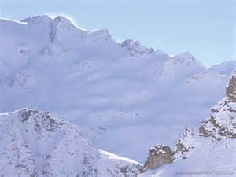

WELCOME
&
ANNOUNCEMENTS

Slide 5
Sanctus: MV#7
Ga....ther us in, ground us..........in you..........
Ga....ther us in,
ground us..........in you...........
Ga....ther us in..........
Ga....ther us in..........
ground us.......... ground us..... in you.~

Slide 7

LIGHTING OF THE CANDLES

Slide 9
*CALL TO WORSHIP:
One: We are called to turn the other cheek.
All: We will seek to be vulnerable in our lives of faith and service.
One: We are called to go the extra mile.

Slide 10
All: We will be with those around us in the journeys of hope as well as fear.
One: We are called to love those who make that so hard.
All: We will rely on the One who loves us to fill us with that special grace.

Slide 12
*OPENING PRAYER:
You are God, Master Builder, so holy, we cannot understand, yet you turn the pages of your heart, so we might learn to love; so creative, we stand open-mouthed in awe and wonder, yet you teach us the words than can bring hope to those who need it

Slide 13
most. You are God, Wordsmith of new sayings, so gentle, some might think you weak, yet you dare to love those who confront you; so tolerant, some might think you naive, yet you are wise enough to always let us make fools of ourselves. You are God, Giver of wisdom, so exalted in glory, we lower our eyes, yet you

Slide 14
move into our hearts in order to renovate our lives; so perfect in wonder, we tiptoe away, yet you stick with us until we are all grown-up in faith. You are God, and we gather in these moments to worship you. Amen.

Slide 16
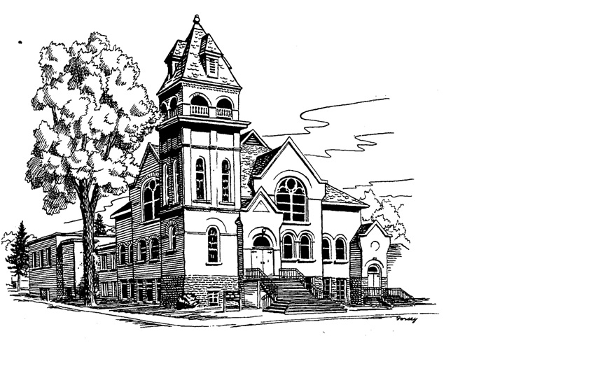
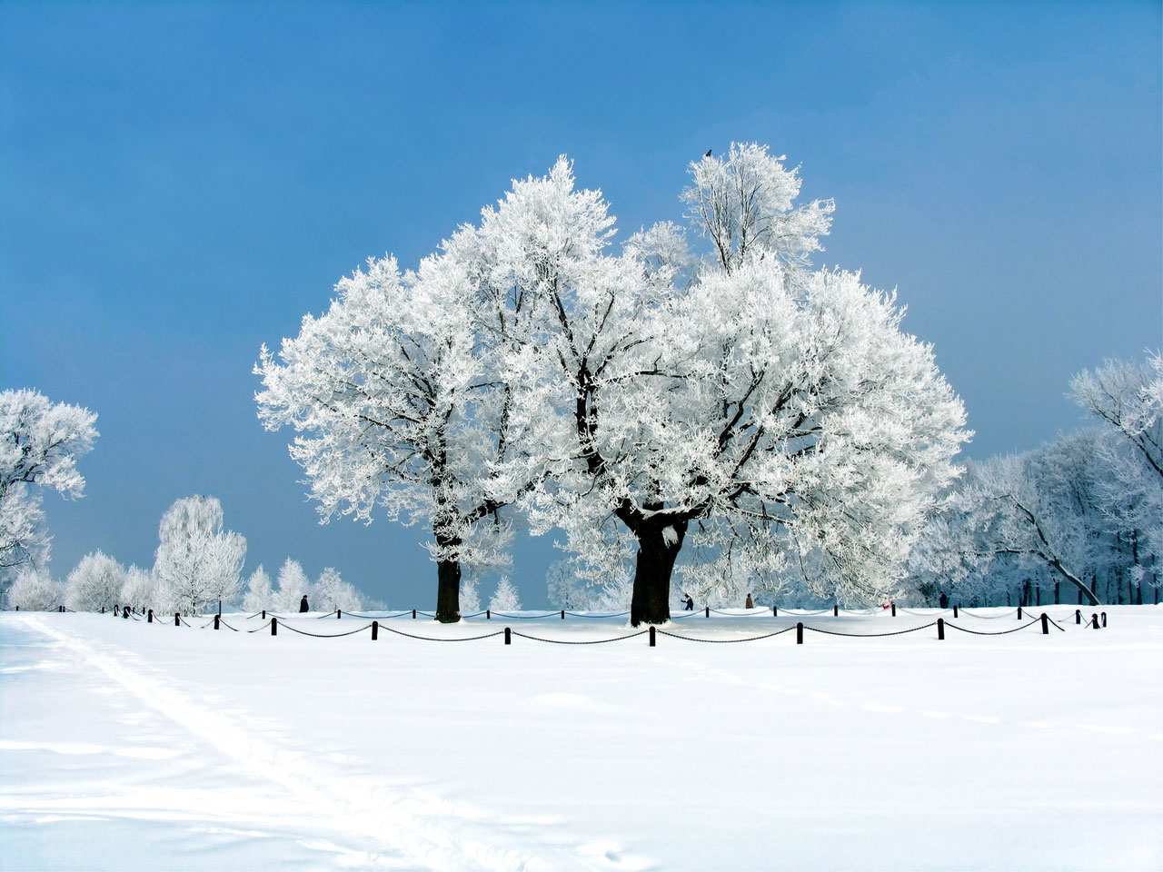
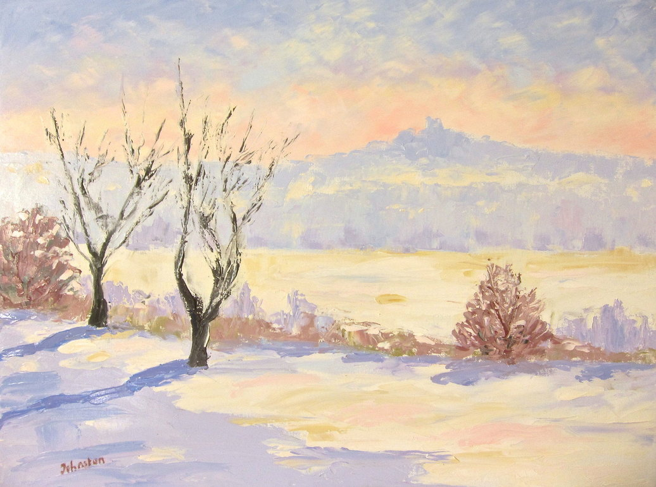
*OPENING HYMN: VU#331
“The Church’s One Foundation”
HYMN: #331
“The Church’s One Foundation”

Slide 17
The church's one foundation is Jesus Christ our Lord;
we are his new creation by water and the Word;
from heaven he came and sought us that we might ever be
his living servant people, by his own death set free.

Slide 18
Called forth from every nation, yet one o'er all the earth;
one charter of salvation: one Lord, one faith, one birth.
One holy name professing and at one table fed,
to one hope always pressing, by Christ's own Spirit led.

Slide 19
Though with a scornful wonder the world sees us oppressed,
by schisms rent asunder, by heresies distressed,
yet saints their watch are keeping; their cry goes up, 'How long?‘
But soon the night of weeping shall be the morn of song.

Slide 20
Mid toil and tribulation, and tumult of our war,
we wait the consummation of peace forevermore;
till with the vision glorious our longing eyes are blest,
and the great church victorious shall be the church at rest.

Slide 21
We now on earth have union with God the Three in One,
and share through faith communion with those whose rest is won.
Oh, happy ones, and holy! Lord, give us grace that we
like them, the meek and lowly, on high may dwell with thee.~

Slide 23
PRAYER OF CONFESSION:
One: God would teach us all we need in order to live in peace, to love others, to walk the right paths. Let us confess how foolish we are when we choose not to listen to such wisdom, as we pray together, saying,

Slide 24
All: A friend hurts us, we hurt them back; someone hits us, we strike back; a family member ridicules us, we gossip about him or her. That is how we have been taught to deal with those around us. But now, God of mercy, you call us to a different life the life of forgiving, not avenging; the life of peace, not

Slide 25
anger; the life of love, not hate. As you forgive us of all we have done, and not done may we walk in your new ways of living, as we follow Jesus the Christ. Amen

Slide 27
WORDS OF ASSURANCE:
One: It begins with God and ends with God – that love which can create, renew, restore. God loves you and forgives you – now and forever.
All: As we listen to God’s songs of mercy, we are cradled in grace – now and forever. Amen.

Slide 29
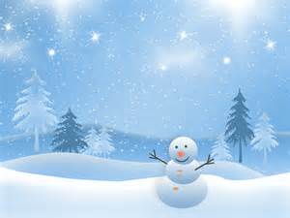
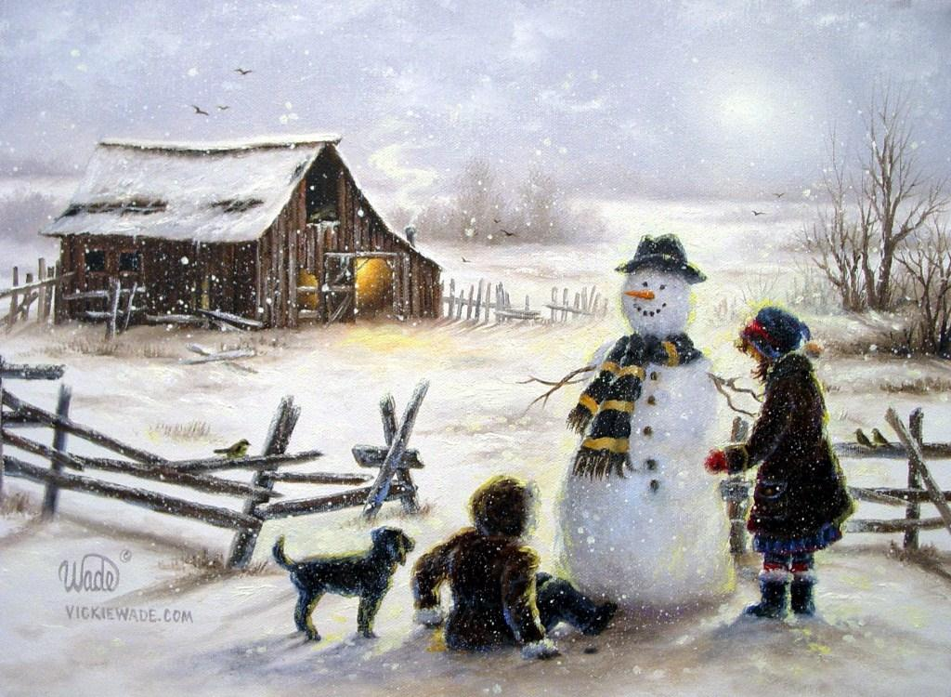
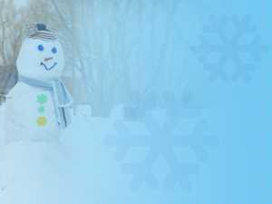
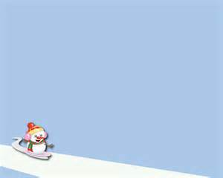
CHILDREN’S TIME

Slide 31
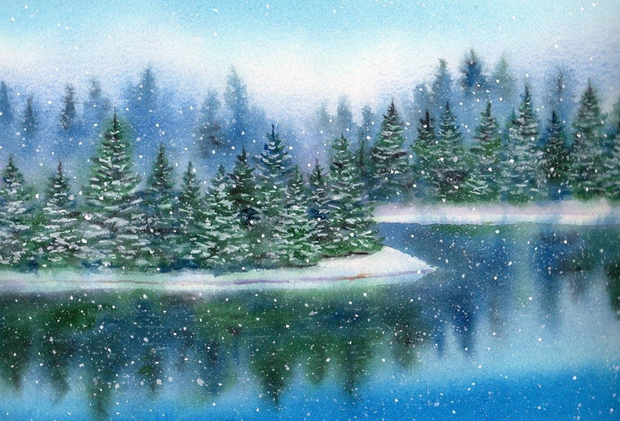
*HYMN: VU#348
“O Love How Deep, How Broad,
How High”

Slide 32
O love, how deep, how broad, how high!
It fills the heart with ecstasy,
that God, in Jesus Christ, should take
our mortal form for mortals' sake.

Slide 33
God sent no angel to our race
of higher or of lower place,
but wore the robe of human frame,
and freely to this lost world came.

Slide 34
For us he was baptized, and bore
a holy fast, and hungered sore;
for us temptations sharply knew;
for us the tempter overthrew.

Slide 35
For us he prayed, for us he taught,
for us great daily works were wrought,
by words and signs, and actions, thus
still seeking not himself, but us.

Slide 36
For us to wicked foes betrayed,
scourged, mocked, in purple robe arrayed,
he bore the shameful cross and death;
for us at length gave up his breath.

Slide 37
For us he rose from death again,
for us he went on high to reign,
for us he sent his Spirit here
to guide, to strengthen and to cheer.

Slide 38
To God whose boundless love has won
salvation for us through the Son,
to God all praise and glory be
both now and through eternity.~

Slide 40

SCRIPTURE:
1 Corinthians 3:10-11, 16-23
Val Green

Slide 41
According to the grace of God given to me, like a skilled master builder I laid a foundation, and someone else is building on it. Each builder must choose with care how to build on it. ¹¹ For no one can lay any foundation other than the one that has been laid; that foundation is Jesus Christ.
According to the grace of God given to me, like a skilled master builder I laid a foundation, and someone else is building on it. Each builder must choose with care how to build on it. For no one can lay any foundation other than the one that has been laid; that foundation is Jesus Christ.

Slide 42
Do you not know that you are God’s temple and that God’s Spirit dwells in you? If anyone destroys God’s temple, God will destroy that person. For God’s temple is holy, and you are that temple. Do not deceive yourselves. If you think that you are wise in this age, you should become fools so that you may become wise. For the wisdom of this world is foolishness with God. For it is written,
“He catches the wise in their craftiness,”
²⁰ and again,
“The Lord knows the thoughts of the wise,
that they are futile.”
²¹ So let no one boast about human leaders. For all things are yours, ²² whether Paul or Apollos or Cephas or the world or life or death or the present or the future—all belong to you, ²³ and you belong to Christ, and Christ belongs to God.

Slide 43
of this world is foolishness with God. For it is written, “He catches the wise in their craftiness,” and again, “The Lord knows the thoughts of the wise, that they are futile.” So let no one boast about human leaders. For all things are yours, whether Paul or Apollos or Cephas or the world or life or death or the present or the future—all

Slide 44
belong to you, and you belong to Christ, and Christ belongs to God.

Slide 46

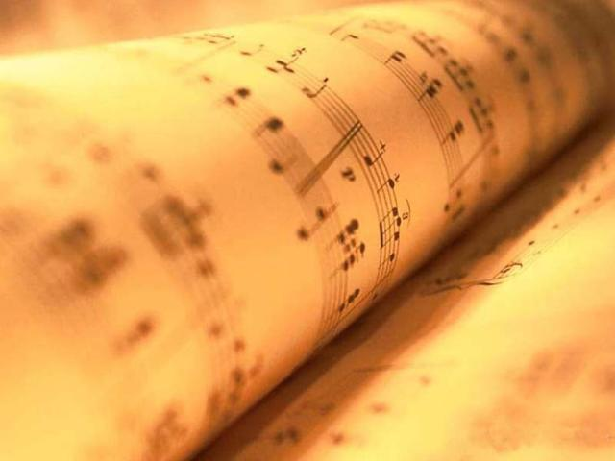
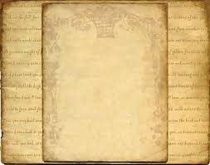
MINISTRY OF MUSIC:
Jack Glaves

Slide 48
SCRIPTURE:
Matthew 5:38-48
Val Green

Slide 49
Concerning Retaliation
“You have heard that it was said, ‘An eye for an eye and a tooth for a tooth.’ But I say to you, Do not resist an evildoer. But if anyone strikes you on the right cheek, turn the other also; and if anyone wants to sue you and take your coat, give your cloak as well; and if anyone forces you to go one mile, go also the second

Slide 50
mile. Give to everyone who begs from you, and do not refuse anyone who wants to borrow from you.
Love for Enemies
“You have heard that it was said, ‘You shall love your neighbor and hate your enemy.’ But I say to you, Love your enemies and pray for those who persecute you, so that you may be children of your Father in heaven; for

Slide 51
he makes his sun rise on the evil and on the good, and sends rain on the righteous and on the unrighteous. For if you love those who love you, what reward do you have? Do not even the tax collectors do the same? And if you greet only your brothers and sisters, what more are you doing than others? Do not even the Gentiles do the same? Be perfect, therefore, as your heavenly Father is perfect.

Slide 53

SERMON

Slide 55
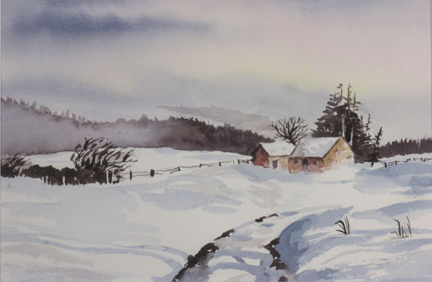
*HYMN: VU#595
“The Servant Song”

Slide 56
We are pilgrims on a journey,
fellow travellers on the road;
we are here to help each other
walk the mile and bear the load.

Slide 57
Sister, let me be your servant,
let me be as Christ to you;
pray that I may have the grace to
let you be my servant too.

Slide 58
I will hold the Christ-light for you
in the night-time of your fear;
I will hold my hand out to you,
speak the peace you long to hear.

Slide 59
I will weep when you are weeping,
when you laugh I'll laugh with you;
I will share your joy and sorrow,
till we've seen this journey through.

Slide 60
When we sing to God in heaven,
we shall find such harmony,
born of all we've known together
of Christ's love and agony.

Slide 61
Brother, let me be your servant,
let me be as Christ to you;
pray that I may have the grace to
let you be my servant too.~

Slide 63
OFFERING: VU#542
We give you but your own,
whate'er the gift may be;
all that we have is yours alone,
we give it gratefully.~

Slide 65
OFFERTORY PRAYER:
We are called to share with everyone – our coats, our cloaks, our love, our forgiveness. May these gifts we offer be tangible hope to those walking in despair, real food for hungry children, safe shelter for the homeless, peace and

Slide 66
reconciliation for the broken. This we ask in the name of Jesus. Amen.

Slide 68
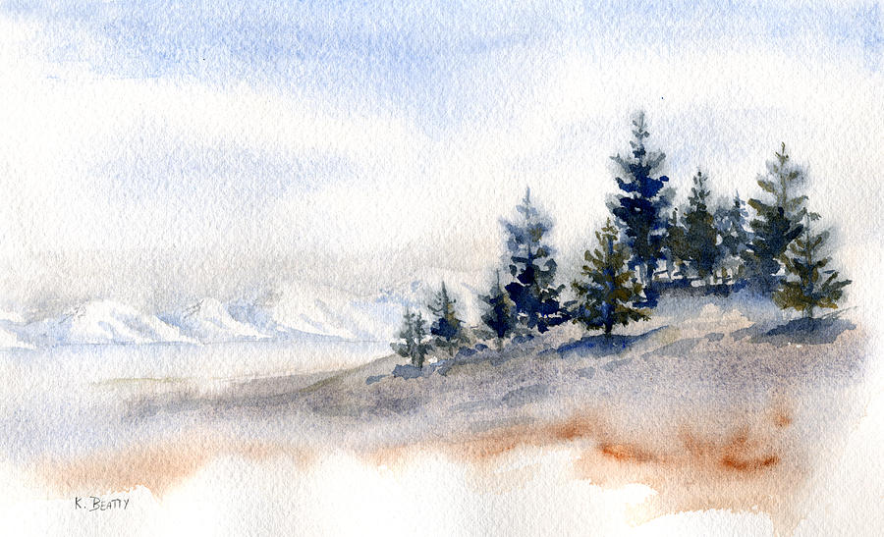
*CLOSING HYMN: VU pg. 822
“All People That On Earth Do Dwell”

Slide 69
All people that on earth do dwell,
sing out your faith with cheerful voice;
delight in God whose praise you tell,
whose presence calls you to rejoice.

Slide 70
Know that there is one God, indeed,
who fashions us without our aid,
who claims us, gives us all we need,
whose tender care will never fade.

Slide 71
Enter the sacred gates with praise;
with joy approach the temple walls.
Extol and bless our God always
as people whom the Spirit calls.

Slide 72
Proclaim again that God is good,
whose mercy is forever sure,
whose truth at all times firmly stood,
and shall from age to age endure.~

Slide 74
*BLESSING:
One: God teaches us to love, even imperfect people like ourselves.
All: We go to love those all around us.
One: God would teach us to deny ourselves, even walking the extra mile with us.

Slide 75
All: We will seek give ourselves to others as generously as Jesus has been given to us.

Slide 77
*CHORAL RESPONSE: MV#214
May...God’s...shel-ter-ing wings, his gath-er-ing wings,
Pro-tect...you....
May...God’s...nurturing arms, his
Crad-ling arms sustain.... You......
and
Hold...you in his love.....and
Hold...you in his love.

Slide 78
May...God’s...sheltering wings, her gath-er-ing wings,
Pro-tect...you....May...God’s...
nurturing arms, her
Cradling arms sustain...you........
and
Hold...you in her love.....and
hold...you in her love.~

Slide 80

Everyone is invited and encouraged to come for coffee in the LA Hall following service!
Please remember to return your nametag.

