Slide 1



Slide 3


Slide 5
Sanctus: MV#7
Ga....ther us in, ground us..........in you..........
Ga....ther us in,
ground us..........in you...........
Ga....ther us in..........
Ga....ther us in..........
ground us.......... ground us..... in you.~

Slide 7

LIGHTING OF THE CANDLES

Slide 9
*CALL TO WORSHIP:
One: We gather as the faithful of God. We come to listen to what God has to say to us.
All: God has invited us to this place; may our faces reflect our hopes and our hearts.
One: We gather as the faithful of God, people of the new covenant

Slide 10
of hope and promise.
All: We boldly enter into the presence of God, hoping to be transformed into new people.
One: We gather as the faithful of God, our fears melting away in the heart of God.
All: We come to share in the freedom of the Spirit. We come to praise God’s holy name.

Slide 12
*OPENING PRAYER:
One: Majestic Glory, loving God, on mountaintops crowned with mist and in museums filled with wonder; in tents pitched alongside singing brooks, and in theatres filled with laughing children; in this sacred space and in all the ordinary neighbourhoods where we live, you

Slide 13
are with us, hearing us, answering us. And, so, we do not lose heart. Jesus, Beloved of God, we glance at you from the corners of our souls, and see grace surrounding us; we look at you conversing with the poor and rejected, and see our family; we watch you as you come to us, to touch us, to heal us, and to reconcile us to God. And, so, we

Slide 14
do not lose heart. Holy Spirit, listening God when our lips cannot shape words, you speak them for us; when we can only sigh our needs, you gather them up and speak them for us. When our hopes are dashed to the ground, you pick them up and give them back to us. And, so, we do not lose heart.

Slide 15
All: We do not lose heart as we gather in worship this day. Amen

Slide 17

OPENING HYMN: VU#415
“God We Praise You For The Morning”

Slide 18
God, we praise you for the morning;
hope springs forth with each new day,
new beginning, prayer, and promise,
joy in work and in play.

Slide 19
God, we praise you for creation,
mountains, seas, and prairie land.
Waking souls find joy and healing
in your bountiful hand.

Slide 20
God, we praise you for compassion,
all the loving that you show;
human touching, tears, and laughter,
help your children to grow.

Slide 21
God, we praise you for your Spirit,
Comforter and daily friend,
restless searcher, gentle teacher,
strength and courage you send.

Slide 22
God, we praise you for the Saviour,
come that we may know your ways.
In his loving, dying, rising,
Christ is Lord of our days.

Slide 23
Hallelujah, hallelujah,
hallelujah, hallelujah!
Hallelujah, hallelujah!
Christ is Lord of our days!~

Slide 25
PRAYER OF CONFESSION:
One: God calls us into the presence of glory in these moments, not to judge and condemn us, but to forgive and set us free. Let us bring our prayers to God who longs to embrace us with mercy, as we pray saying,
All: We may not actively

Slide 26
conspire against you, gracious God, but we do make those conscious choices which draw us away from you. We fear ridicule from neighbours and co-workers, and so do not mention who you are in our lives. We want to walk your path, but find ourselves going down rabbit trails which lead to trouble. We

Slide 27
find it so easy to listen to the seductive words of our culture, but have trouble hearing your whispers of hope and healing. Forgive us, Revealer of mystery and wonder. Call us to that discipleship that is found on mountaintops in your presence, and in the valleys where we serve others in your name. As

Slide 28
people of faith, we would not stay here, but follow Jesus the Christ into every place that longs for your glory and your grace, your strength as well as your gentleness. Amen

Slide 30
WORDS OF ASSURANCE:
One: Listen! You are God’s children, the beloved of God’s heart. God speaks words of healing and hope to you in these moments. Listen!
All: It is good to be here in the presence of the One who forgives us. Thanks be to God. Amen.

Slide 32

CHILDREN’S TIME

Slide 34
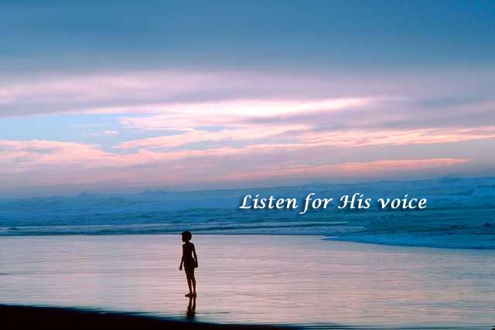
*Hymn: VU#299
“Teach Me God To Wonder”

Slide 35
Teach me, God, to wonder, teach me, God, to see;
let your world of beauty capture me.
Praise to you be given, love for you be lived,
life be celebrated, joy you give.

Slide 36
Let me, God, be open, let me loving be;
let your world of people speak to me.
Praise to you be given, love for you be lived,
life be celebrated, joy you give.

Slide 37
Let me, God, be ready, let me be awake,
in your world of loving my place take.
Praise to you be given, love for you be lived,
life be celebrated, joy you give.

Slide 38
Teach me, God, to know you, hear you when you speak,
see you in my neighbour when we meet.
Praise to you be given, love for you be lived,
life be celebrated, joy you give.~

Slide 40

SCRIPTURE:
Exodus 24:12-18
Valerie Green

Slide 41
The Lord said to Moses, “Come up to me on the mountain, and wait there; and I will give you the tablets of stone, with the law and the commandment, which I have written for their instruction.” So Moses set out with his assistant Joshua, and Moses went up into the mountain of God. To the elders he had said, “Wait here for us, until we come to you again; for Aaron

Slide 42
and Hur are with you; whoever has a dispute may go to them.” Then Moses went up on the mountain, and the cloud covered the mountain. The glory of the Lord settled on Mount Sinai, and the cloud covered it for six days; on the seventh day he called to Moses out of the cloud. Now the appearance of the glory of the Lord was like a devouring fire on

Slide 43
the top of the mountain in the sight of the people of Israel. ¹⁸ Moses entered the cloud, and went up on the mountain. Moses was on the mountain for forty days and forty nights.

Slide 45

~Kirby Good

Slide 47
SCRIPTURE:
Matthew 17:1-9
Valerie Green

Slide 48
The Transfiguration
Six days later, Jesus took with him Peter and James and his brother John and led them up a high mountain, by themselves. And he was transfigured before them, and his face shone like the sun, and his clothes became dazzling white. Suddenly there appeared to them Moses and Elijah, talking with him. Then Peter said to

Slide 49
Jesus, “Lord, it is good for us to be here; if you wish, I will make three dwellings here, one for you, one for Moses, and one for Elijah.” While he was still speaking, suddenly a bright cloud overshadowed them, and from the cloud a voice said, “This is my Son, the Beloved; with him I am well pleased; listen to him!” When the disciples heard this, they fell to the

Slide 50
ground and were overcome by fear. But Jesus came and touched them, saying, “Get up and do not be afraid.” And when they looked up, they saw no one except Jesus himself alone. As they were coming down the mountain, Jesus ordered them, “Tell no one about the vision until after the Son of Man has been raised from the dead.”

Slide 52

SERMON

Slide 54

*HYMN: VU p.894
“We Praise Thy Name”

Slide 55
Holy God, we praise your name;
God of all, we bow before you.
All on earth your sceptre claim;
all in heaven above adore you.
Infinite your vast domain; everlasting is your reign.

Slide 56
Hark, the glad celestial hymn
angel choirs above are raising;
cherubim and seraphim,
in unceasing chorus praising,
fill the heavens with sweet accord: 'Holy, holy, holy Lord.'

Slide 57
Lo, the apostolic train
joins your sacred name to hallow;
prophets swell the glad refrain,
and the white-robed martyrs follow;
and from morn till set of sun
through the Church the song goes on.

Slide 58
Glory through eternity:
Spirit, Word, and blest Creator.
God of gracious tenderness,
at your feet we sinners gather;
light and mercy, now, we pray, give your people for this day.~

Slide 60
*OFFERING: #541
Praise God from whom all blessings flow;
praise God, all creatures high and low;
give thanks to God in love made known:
Creator, Word and Spirit, One.~

Slide 62
OFFERTORY PRAYER:
There is so much we could do with our abundance, Mountaintop God – building grand cathedrals, creating great endowments (and we do). So remind us, as we offer our gifts this morning, of those who need a simple home, who long to hear the songs of hope, who need

Slide 63
help with paying for food or medicine or clothes. Transfigure not only our gifts, but our hearts as well, we pray. Amen

Slide 65
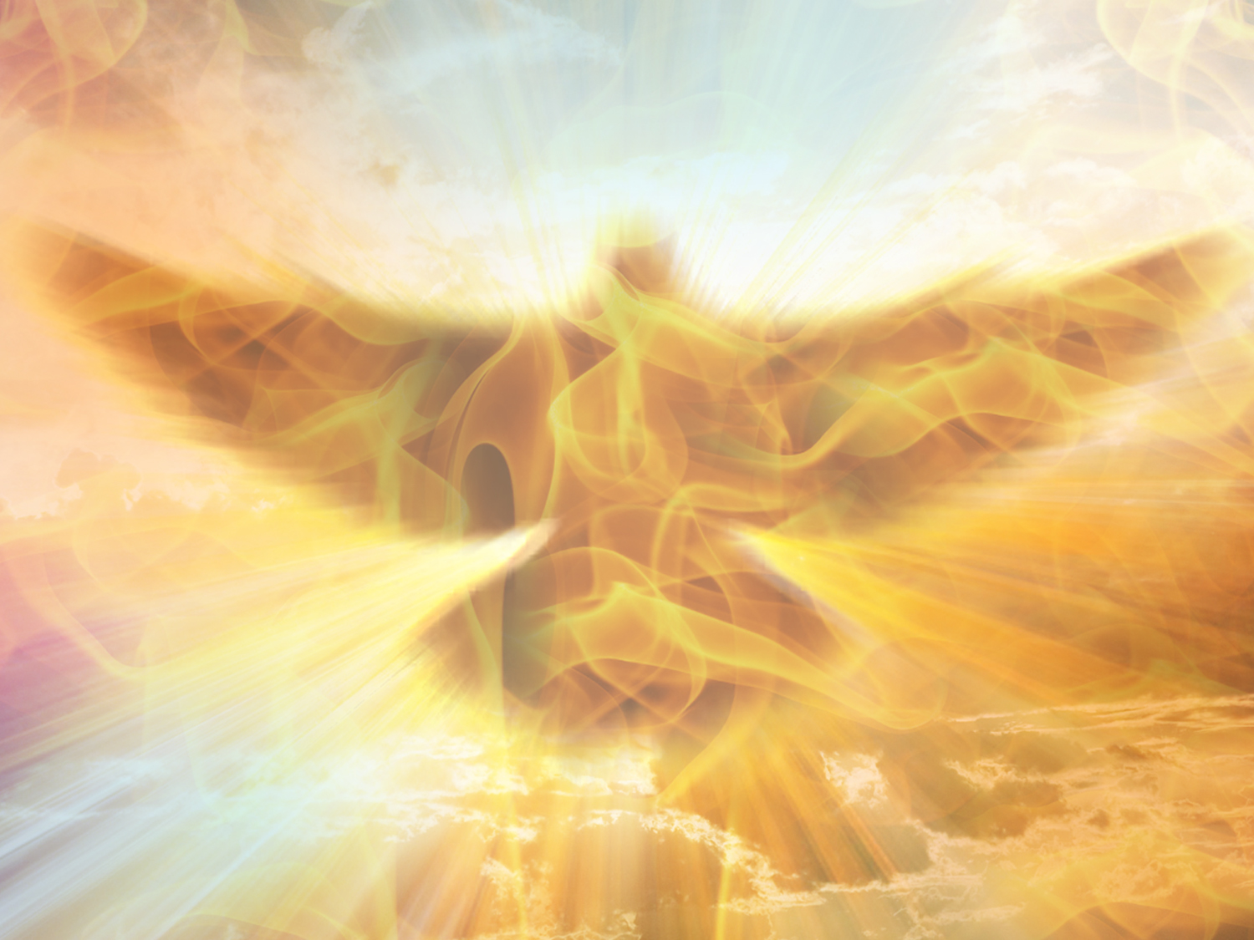
PRAYERS OF THE PEOPLE

Slide 67

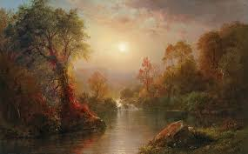
*CLOSING HYMN: VU#264
“Immortal, Invisible God Only Wise”
*CLOSING HYMN VU #264
“Immortal Invisible, God Only Wise”

Slide 68
Immortal, invisible, God only wise;
in light inaccessible hid from our eyes;
most blessed, most glorious, the Ancient of Days,
almighty, victorious, thy great name we praise.

Slide 69
Unresting, unhasting, and silent as light,
nor wanting, nor wasting, thou rulest in might;
thy justice like mountains high soaring above
thy clouds, which are fountains of goodness and love.

Slide 70
To all, life thou givest, to both great and small;
in all life thou livest, the true life of all;
we blossom and flourish like leaves on the tree,
then wither and perish; but naught changeth thee.

Slide 71
Thou reignest in glory, thou rulest in light;
thine angels adore thee, all veiling their sight;
all praise we would render, O help us to see
'tis only the splendour of light hideth thee!~

Slide 73
*BLESSING:
One: Tempted to stay here, let us go,
All: to carry God’s peace to a broken world.
One: Having heard the call to follow,
All: we will journey into life’s valleys, carrying the hope of Jesus.

Slide 74
One: We will walk with the Spirit who leads us on a journey of humility.
All: We will walk through fears that threaten to burn us, as well as the mist of uncertain days and nights.

Slide 76
*CHORAL RESPONSE: MV#214
May...God’s...shel-ter-ing wings, his gath-er-ing wings,
Pro-tect...you....
May...God’s...nurturing arms, his
Crad-ling arms sustain.... You......
and
Hold...you in his love.....and
Hold...you in his love.

Slide 77
May...God’s...sheltering wings, her gath-er-ing wings,
Pro-tect...you....May...God’s...
nurturing arms, her
Cradling arms sustain...you........
and
Hold...you in her love.....and
hold...you in her love.~

Slide 79

Everyone is invited and encouraged to come for coffee in the LA Hall following service!
Please remember to return your nametag.

