Slide 1



Slide 3

WELCOME & ANNOUNCEMENTS

Slide 5
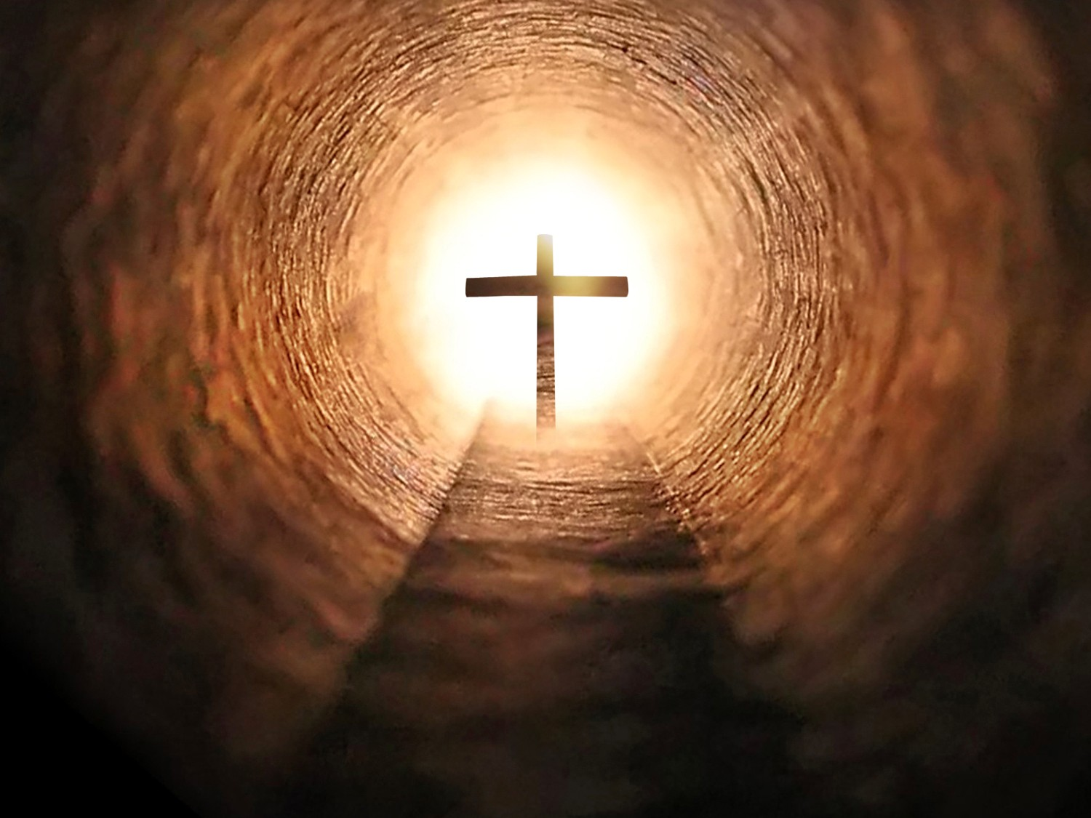
*SANCTUS: VU#155
“Jesus Christ is Risen Today”

Slide 6
Jesus Christ is risen today, hallelujah!
our triumphant holy day, hallelujah!
who did once, upon the cross, hallelujah!
suffer to redeem our loss. Hallelujah!

Slide 7
Hymns of praise then let us sing hallelujah!
unto Christ, our heavenly King, hallelujah!
who endured the cross and grave, hallelujah!
sinners to redeem and save. Hallelujah!

Slide 8
But the pains which he endured, hallelujah!
our salvation have procured; hallelujah!
now above the sky he's King, hallelujah!
where the angels ever sing. Hallelujah!

Slide 9
Sing we to our God above, hallelujah!
praise eternal as God's love; hallelujah!
praise our God, ye heavenly host, hallelujah!
praise the Son and Holy Ghost. Hallelujah!~

Slide 11

*LIGHTING OF THE CANDLES

Slide 13
*CALL TO WORSHIP:
One: Hallelujah! Christ is risen!
All: Christ is risen indeed! Hallelujah!
One: God has said a resounding “Yes!” to the world!
All: Come, let us worship God

Slide 15
*OPENING PRAYER:
Loving God, we lift our hearts in praise. This very day we know that life rules over death. All your promises to your people now hold new meaning. Christ is risen from the dead and we have new life because of that. You had proclaimed “Yes!” as a

Slide 16
challenge to the problems of the world. As we hear that bold proclamation, help us to find new ways to make it our proclamation in our day-to-day living. Amen.

Slide 18
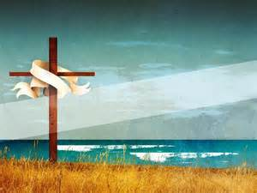
*OPENING HYMN: VU#173
“Thine is Thy Glory”

Slide 19
Thine is the glory, risen, conquering Son:
endless is the victory thou o'er death hast won.
Angels in bright raiment rolled the stone away,
kept the folded grave-clothes where the body lay.

Slide 20
Refrain:
Thine is the glory, risen, conquering Son:
endless is the victory thou o'er death hast won.

Slide 21
Lo, Jesus meets us, risen from the tomb!
Lovingly he greets us, scatters fear and gloom.
Let the church with gladness hymns of triumph sing,
for the Lord now liveth: death hath lost its sting.

Slide 22
Refrain:
Thine is the glory, risen, conquering Son:
endless is the victory thou o'er death hast won.

Slide 23
No more we doubt thee, glorious Prince of life;
life is nought without thee: aid us in our strife;
make us more than conquerors, through thy deathless love;
bring us safe through Jordan to thy home above.

Slide 24
Refrain:
Thine is the glory, risen, conquering Son:
endless is the victory thou o'er death hast won.~

Slide 26
WORDS OF ASSURANCE:
One: On this day of days we celebrate that, no matter what we may have said to God from time to time, God proclaims to us words of hope and forgiveness. No matter what we have done,
know that God forgives you, and loves you, and invites you to

Slide 27
celebrate new life.
All: Thanks be to God! Amen.

Slide 29
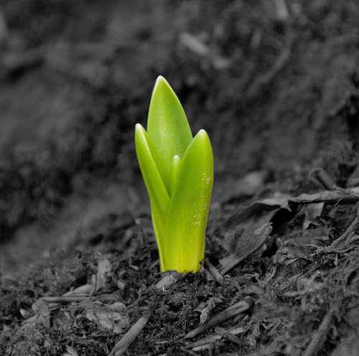
*HYMN: VU#186
“Now the Green Blade Rises”

Slide 30
Now the green blade rises from the buried grain,
wheat that in dark earth many days has lain;
love lives again, that with the dead has been:
love is come again, like wheat arising green.

Slide 31
In the grave they laid him, love by hatred slain,
thinking that he would never wake again,
laid in the earth like grain that sleeps unseen;
love is come again, like wheat arising green.

Slide 32
Forth he came at Easter, like the risen grain,
he that for three days in the grave had lain;
raised from the dead, my living Lord is seen;
love is come again, like wheat arising green.

Slide 33
When our hearts are wintry, grieving, or in pain,
your touch can call us back to life again,
fields of our hearts that dead and bare have been;
love is come again, like wheat arising green.~

Slide 35

CHILDREN’S
TIME

Slide 37
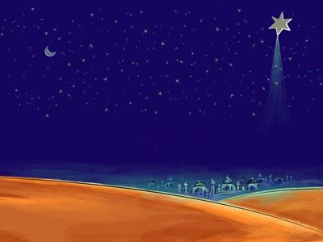
MINISTRY OF MUSIC:
“The Holy City”
Performed by:
Jack Glaves

Slide 39
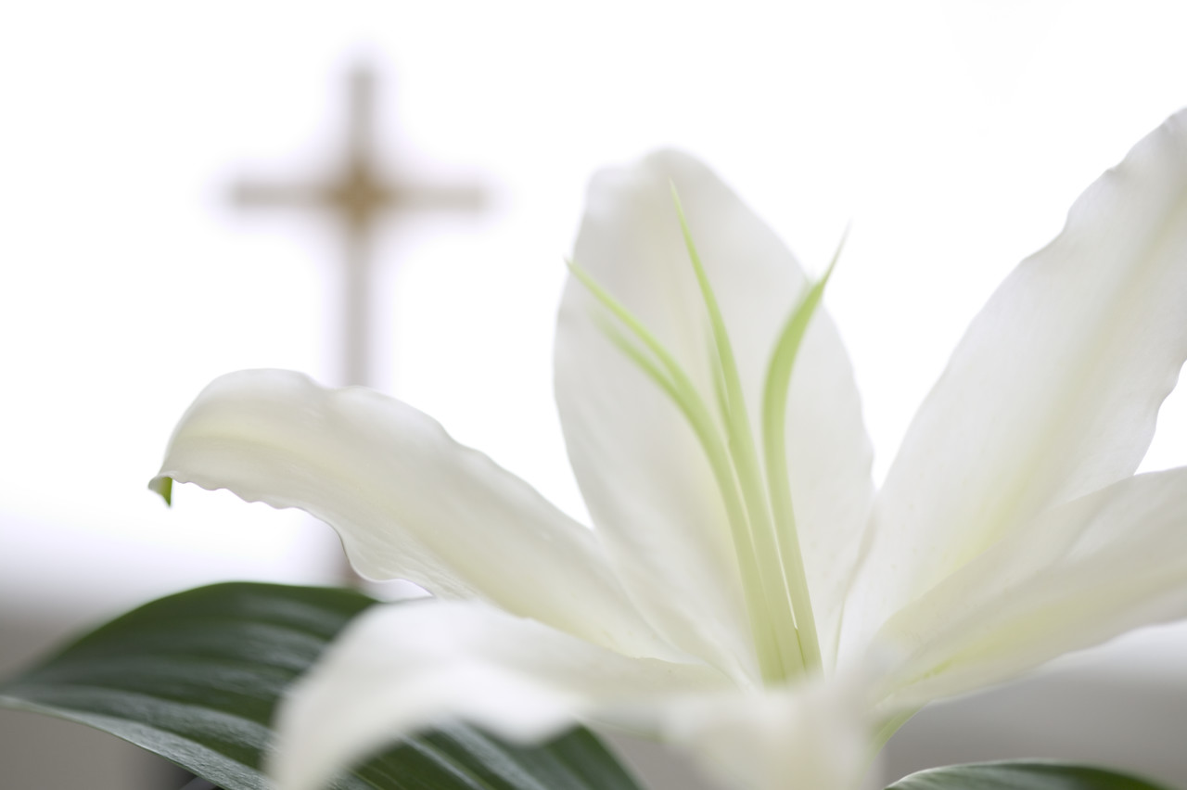
SCRIPTURE:
John 20:1-18
Jack Glaves

Slide 40
The Resurrection of Jesus
Early on the first day of the week, while it was still dark, Mary Magdalene came to the tomb and saw that the stone had been removed from the tomb. So she ran and went to Simon Peter and the other disciple, the one whom Jesus loved, and said to them, “They have taken the Lord out of the tomb, and we do not know

Slide 41
where they have laid him.” Then Peter and the other disciple set out and went toward the tomb. The two were running together, but the other disciple outran Peter and reached the tomb first. He bent down to look in and saw the linen wrappings lying there, but he did not go in. Then Simon Peter came, following him, and went into the tomb. He saw the linen

Slide 42
wrappings lying there, ⁷ and the cloth that had been on Jesus’ head, not lying with the linen wrappings but rolled up in a place by itself. Then the other disciple, who reached the tomb first, also went in, and he saw and believed; for as yet they did not understand the scripture, that he must rise from the dead. Then the disciples returned to their homes.

Slide 43
Jesus Appears to Mary Magdalene
But Mary stood weeping outside the tomb. As she wept, she bent over to look into the tomb; and she saw two angels in white, sitting where the body of Jesus had been lying, one at the head and the other at the feet. They said to her, “Woman, why are you weeping?” She said to them, “They have taken away my Lord, and I

Slide 44
do not know where they have laid him.” When she had said this, she turned around and saw Jesus standing there, but she did not know that it was Jesus. Jesus said to her, “Woman, why are you weeping? Whom are you looking for?” Supposing him to be the gardener, she said to him, “Sir, if you have carried him away, tell me where you have laid him, and I will take him

Slide 45
away.” Jesus said to her, “Mary!” She turned and said to him in Hebrew, “Rabbouni!” (which means Teacher). Jesus said to her, “Do not hold on to me, because I have not yet ascended to the Father. But go to my brothers and say to them, ‘I am ascending to my Father and your Father, to my God and your God.’” Mary Magdalene went and

Slide 46
announced to the disciples, “I have seen the Lord”; and she told them that he had said these things to her.

Slide 48
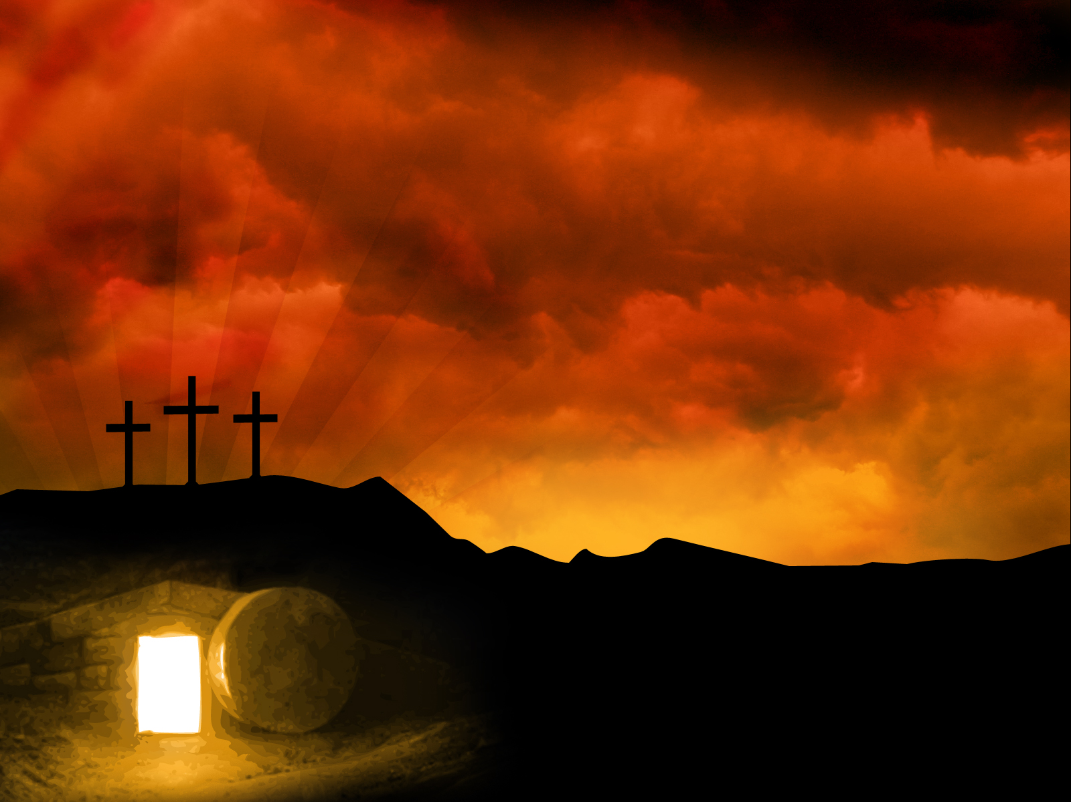
SERMON

Slide 50
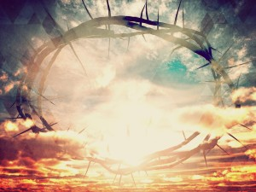
*HYMN: VU#211
“Crown Him With Many Crowns”

Slide 51
Crown him with many crowns,
the Lamb upon his throne:
hark, how the heavenly anthem drowns
all music but its own!
Awake, my soul, and sing
of him who died for thee,
and hail him as thy matchless King
through all eternity.

Slide 52
Crown him the Lord of life,
who triumphed o'er the grave,
and rose victorious in the strife
for those he came to save.
His glories now we sing
who died and rose on high,
who died eternal life to bring,
and lives that death may die.

Slide 53
Crown him the Lord of peace,
whose power a sceptre sways
from pole to pole, that wars may cease,
absorbed in prayer and praise.
His reign shall know no end;
and round his pierced feet
fair flowers of Paradise extend
their fragrance ever sweet.

Slide 54
Crown him the Lord of love;
behold his hands and side,
rich wounds yet visible above,
in beauty glorified.
All hail, Redeemer, hail!
for thou hast died for me;
thy praise shall never, never fail
throughout eternity.~

Slide 56
*OFFERING:
Praise God From Whom all blessings flow,
Praise him all creatures here below
Alleluia, Alleluia!
Praise god above ye heavenly host
Praise father son and holy ghost
Alleluia, Alleluia, Alleluia, Alleluia,
Alleluia

Slide 58
OFFERTORY PRAYER:
As the women drew near to the tomb on Easter morning, ready to give care to a loved one, may we reach out with actions of care and justice and compassion. And as the women left the empty tomb and shared the amazing news of

Slide 59
resurrection, may we witness to the life that is rising up within and all around us. Amen

Slide 61
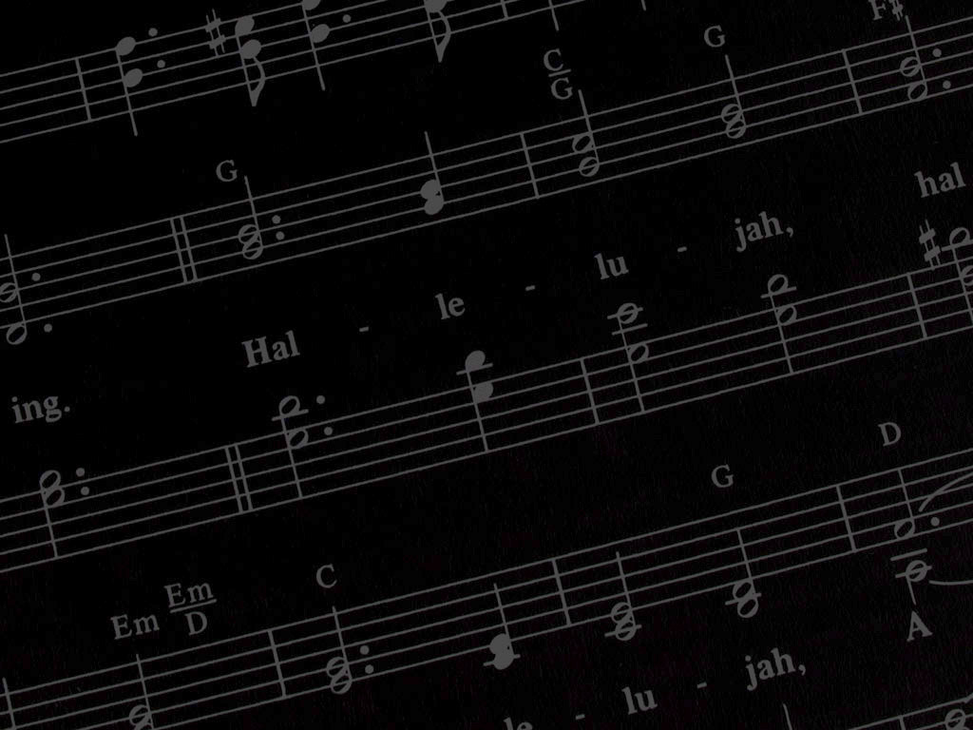
MINISTRY OF MUSIC:
Kirby Good

Slide 63


PRAYERS
OF THE PEOPLE

Slide 65
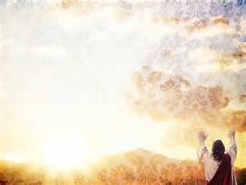
*CLOSING HYMN: VU#179
“Hallelujah, Hallelujah, Give Thanks”

Slide 66
Refrain:
Hallelujah, hallelujah.
Give thanks to the risen Christ;
hallelujah, hallelujah!
Give praise to God's name.

Slide 67
Jesus is Lord of all the earth,
firstborn of all creation.

Slide 68
Refrain:
Hallelujah, hallelujah.
Give thanks to the risen Christ;
hallelujah, hallelujah!
Give praise to God's name.

Slide 69
Spread the good news o'er all the earth:
Jesus has died and is risen.

Slide 70
Refrain:
Hallelujah, hallelujah.
Give thanks to the risen Christ;
hallelujah, hallelujah!
Give praise to God's name.

Slide 71
We have been crucified with Christ,
now we shall live for ever.

Slide 72
Refrain:
Hallelujah, hallelujah.
Give thanks to the risen Christ;
hallelujah, hallelujah!
Give praise to God's name.

Slide 73
Come let us praise the living God,
joyfully sing to our Saviour.

Slide 74
Refrain:
Hallelujah, hallelujah.
Give thanks to the risen Christ;
hallelujah, hallelujah!
Give praise to God's name.~

Slide 76
*CHORAL RESPONSE:
You shall go out with joy
and be led forth with peace;
the mountains and the hills
will break forth before you;
there'll be shouts of joy,
and all the trees of the field
will clap, will clap their hands!

Slide 77
And all the trees of the field will clap their hands,
(clap, clap)
the trees of the field will clap their hands,
(clap, clap)
the trees of the field will clap their hands
(clap, clap)
while you go out with joy.~

Slide 79


