Slide 1

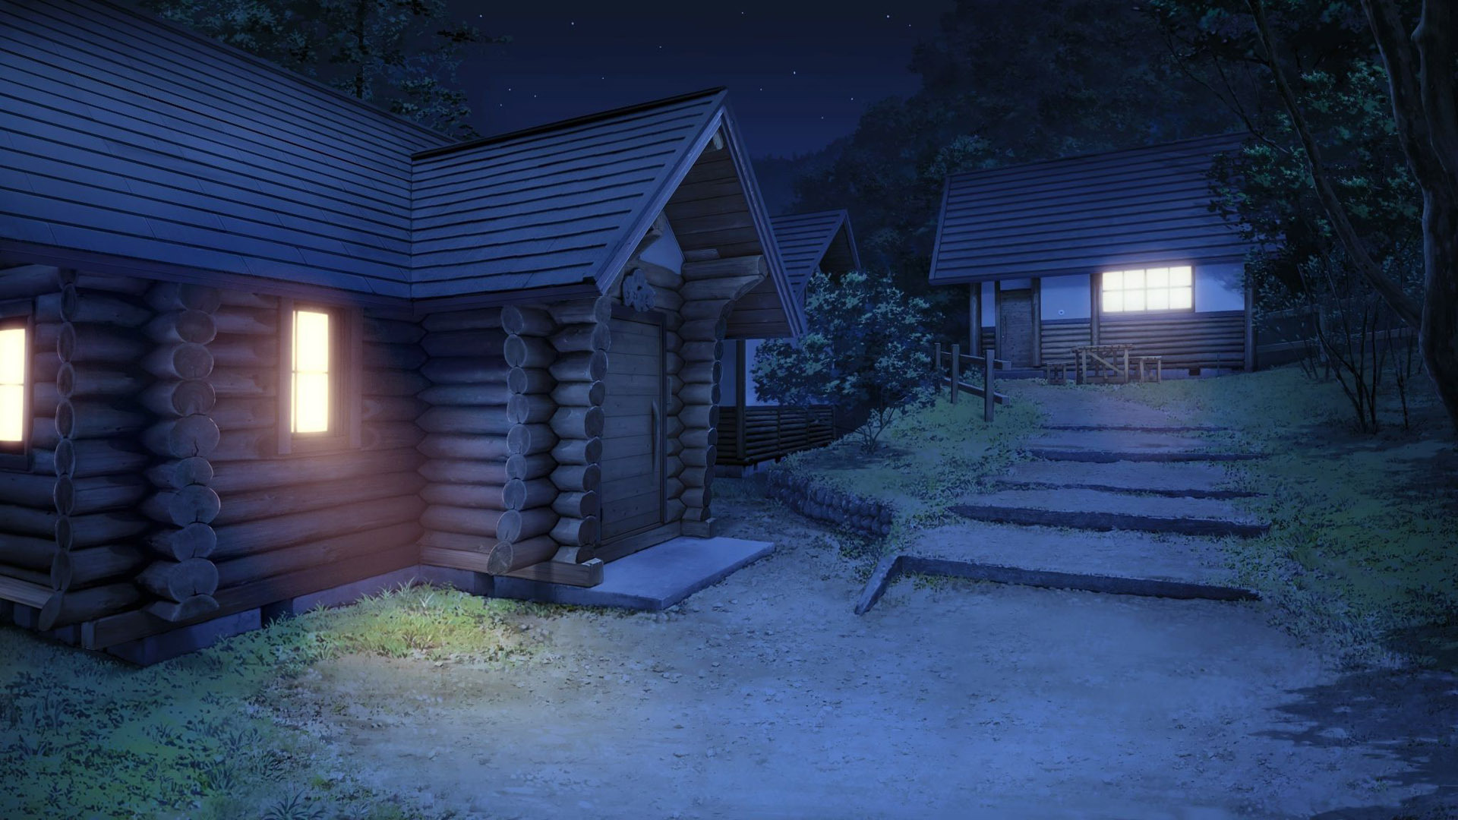
WELCOME
“Camping Sunday”

Slide 3
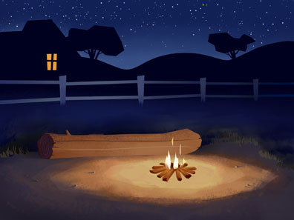
WELCOME & ANNOUNCEMENTS

Slide 5
*Sanctus #315 v.1
Holy, holy, holy! Lord God almighty!
Early in the morning our song shall rise to thee; holy, holy, holy, merciful and mighty, God in three persons, blessed Trinity! ~

Slide 7

*LIGHTING OF THE CANDLES

Slide 9
*CALL TO WORSHIP:
One: God, our Shepherd, invites us to this place.
All: God invites us to rest in grassy meadows, and leads us beside restful waters.
One: God has set a table for us in the presence of our enemies.
All: God has given us so much, it is as if our cup overflows!

Slide 10
One: Come, let us gather in the house of our God.

Slide 12
*OPENING PRAYER:
We gather as followers of Jesus, who embodied love and showed us how to be the very presence of God. May our faith deepen beyond personal piety and mere tradition to become the story we tell with every breath of our lives. Amen.

Slide 14
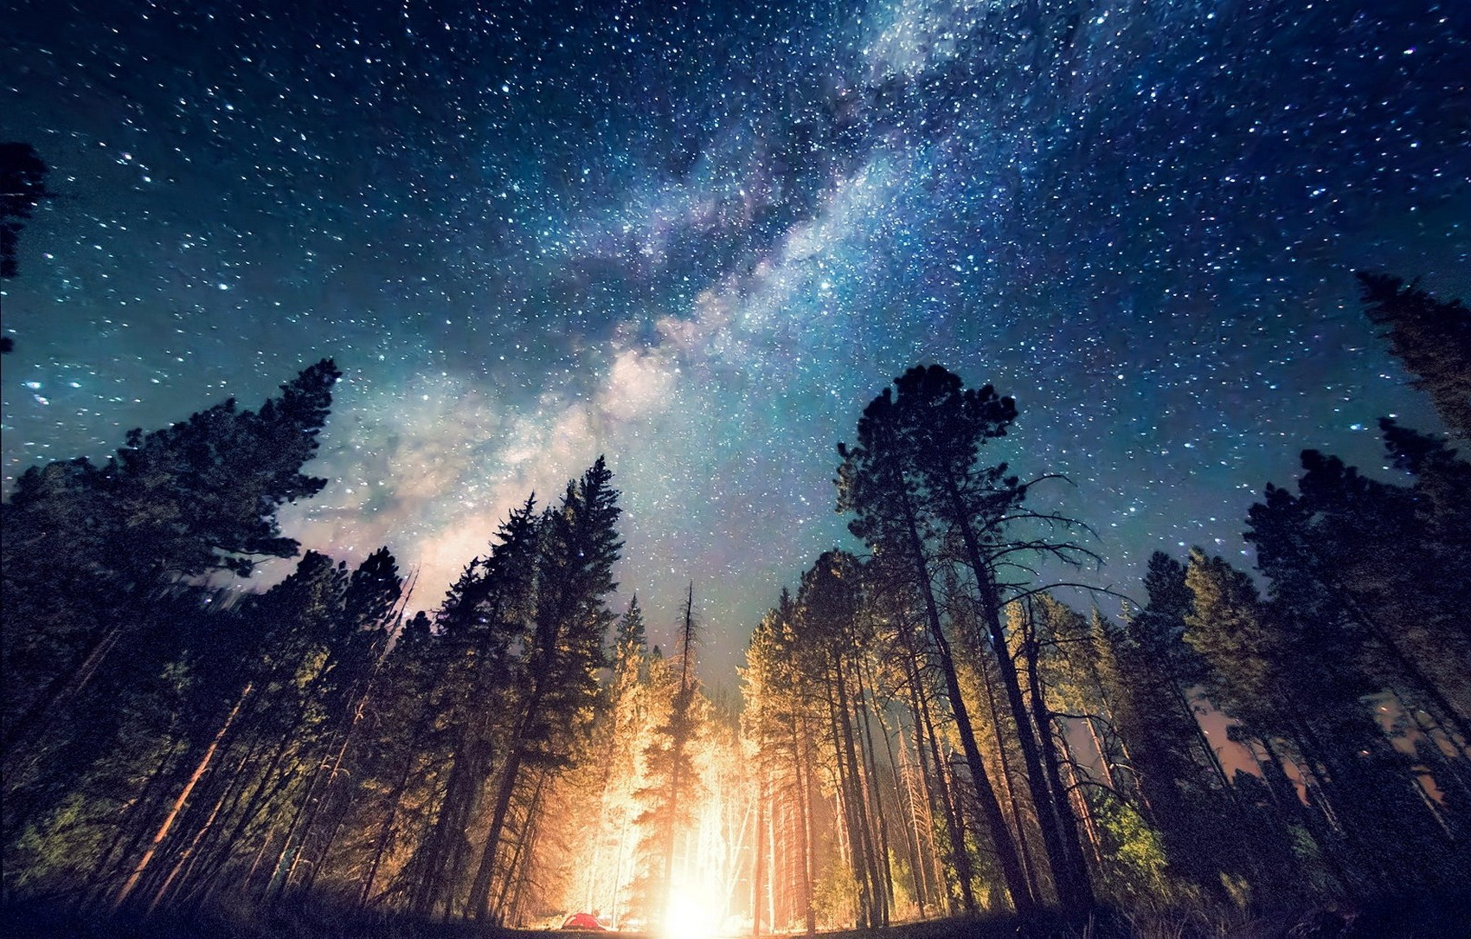
*OPENING HYMN: MV#120
“My Soul Cries Out”

Slide 15
My soul cries out with a joy-ful shout that the God of my heart is great,
And my spir-it sings of the won-drous thing that you bring to the ones who wait.
You fixed your sight on your ser-vant’s plight, and my weak-ness you did not spurn, so from east to west shall my name be blest.
Could the world be a-bout to turn?

Slide 16
Refrain:
My heart shall sing of the day you bring.
Let the fires of your jus-tice burn.
Wipe a-way all tear, for the dawn draws near,
and the world is a-bout to turn!

Slide 17
Though I am small, my God, my all, you work great things in me, and your mer-cy will last from the depths of the past to the end of the age to be.
Your ver-y name puts the proud to shame, and to those who would for you yearn, you will show your might, put the strong to flight, for the world is a-bout to turn.

Slide 18
Refrain:
My heart shall sing of the day you bring.
Let the fires of your jus-tice burn.
Wipe a-way all tear, for the dawn draws near,
and the world is a-bout to turn!

Slide 19
From the halls of the power to the for-tress tower, not a stone will be left on stone.
Let the king be-ware for your
Jus-tice tears ev-’ry ty-rant from his throne.
The hun-gry poor shall weep no more, for the food they can nev-er earn; there are ta-bles spread, ev-’ry mouth be fed, for the world is a-bout to turn.

Slide 20
Refrain:
My heart shall sing of the day you bring.
Let the fires of your jus-tice burn.
Wipe a-way all tear, for the dawn draws near,
and the world is a-bout to turn!

Slide 21
Though the na-tions rage from age to age, we re-mem-ber who holds us fast: God’s mer-cy mu de-liv-er us from the con-quer-or’s crush-ing grasp.
This sav-ing word that our fore-bears heard is the prom-ise which holds us bound, ‘til the spear and rod can be crushed by God,
Who is turn-ing the world a-round.

Slide 22
Refrain:
My heart shall sing of the day you bring.
Let the fires of your jus-tice burn.
Wipe a-way all tear, for the dawn draws near,
and the world is a-bout to turn!~

Slide 24
WORDS OF ASSURANCE:
One: Hear these words from scripture: “Though you were like straying sheep, you have now returned to the shepherd and guardian of your lives.” Friends, know that in the presence of our Shepherd and Saviour Jesus the Christ, our sins are forgiven.
All: Thanks be to God! Amen.

Slide 26
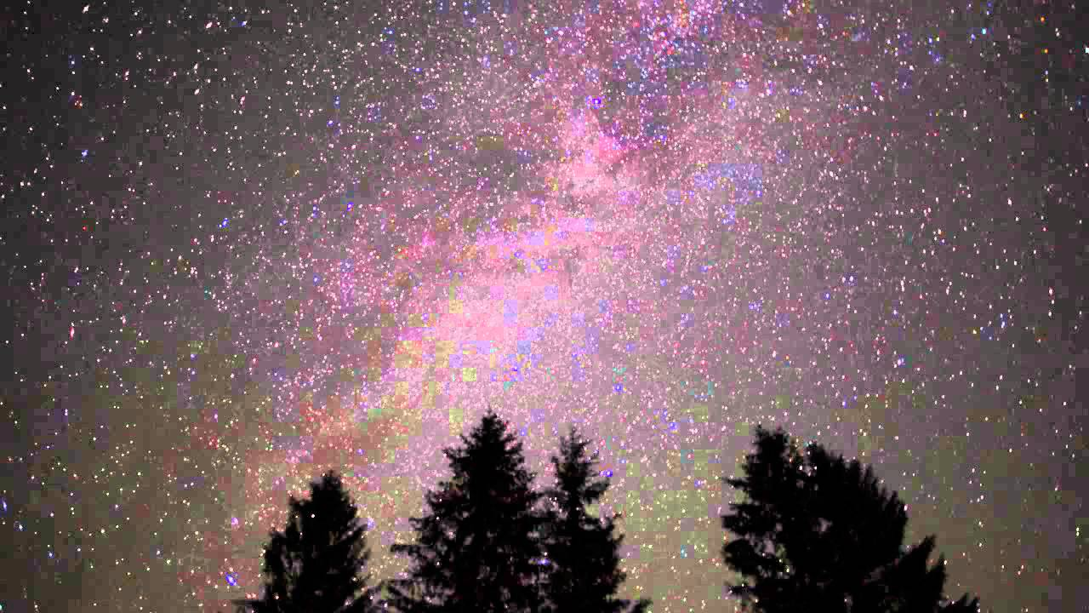
MINISTRY OF MUSIC:
“Amazing Grace”
Performed by:
John & Henry Black
With Gail Squires

Slide 28
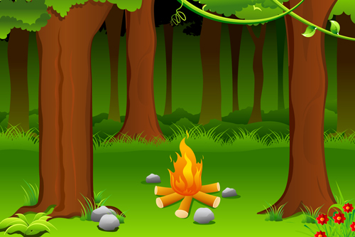
CHILDREN’S TIME

Slide 30
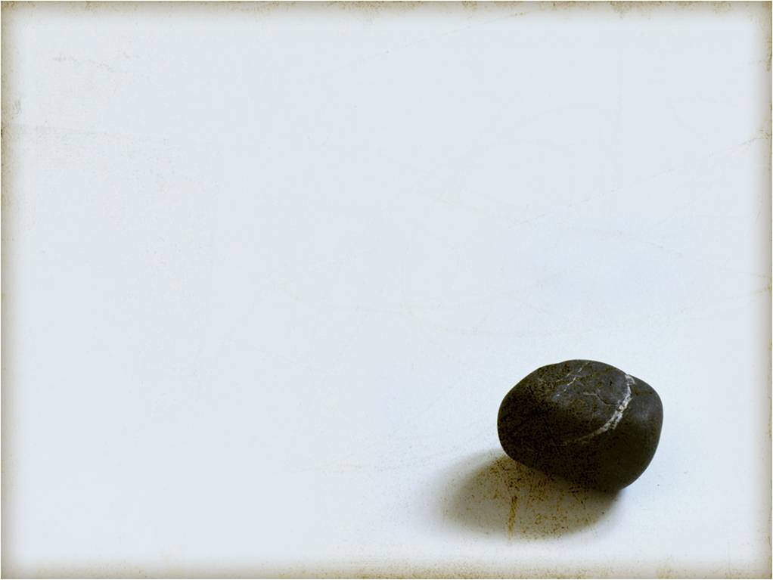
HYMN MV #92
“Like a Rock”

Slide 31
Like a rock, like a rock, God is under our feet.
Like the starry night sky God is over our head.
Like the sun on the horizon God is ever before.
Like the river runs to ocean, our home is in God ever more.~

Slide 33
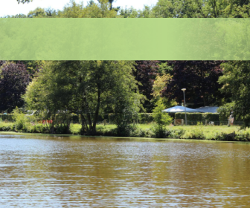
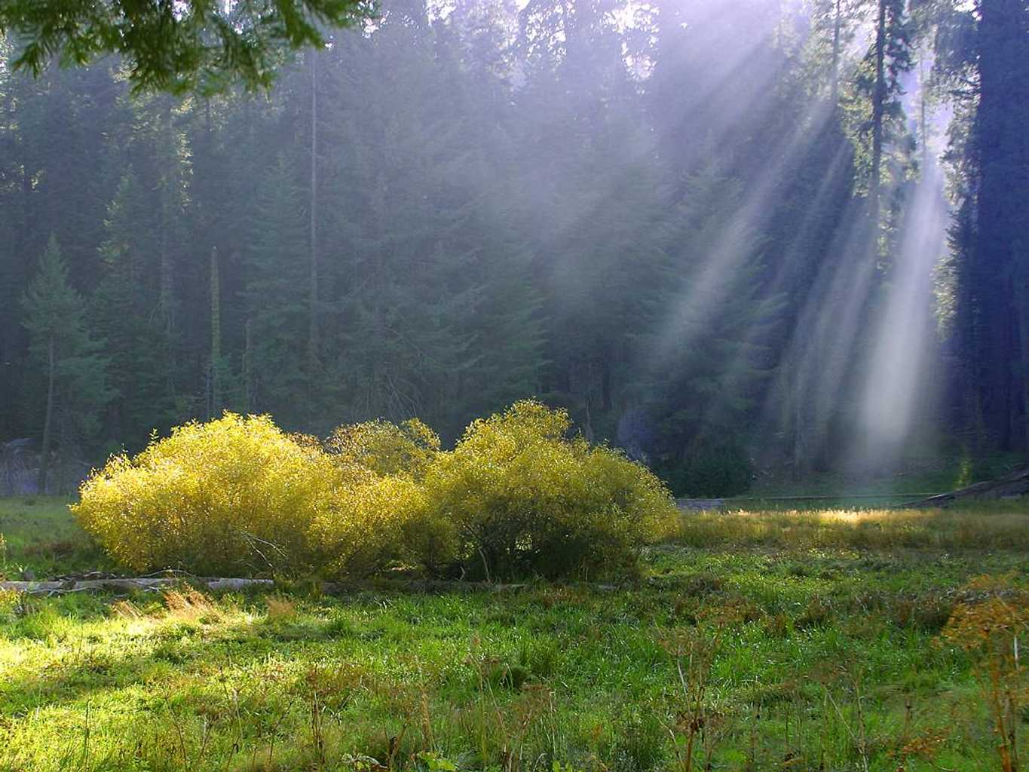
SCRIPTURE:
Acts 2:42-47
Joanne Miron

Slide 34
They devoted themselves to the apostles’ teaching and fellowship, to the breaking of bread and the prayers.
Life among the Believers
Awe came upon everyone, because many wonders and signs were being done by the apostles. All who believed were together and had all things in common; they would sell their possessions and goods and distribute

Slide 35
the proceeds to all, as any had need. Day by day, as they spent much time together in the temple, they broke bread at home and ate their food with glad and generous hearts, praising God and having the goodwill of all the people. And day by day the Lord added to their number those who were being saved.

Slide 36
SCRIPTURE:
John 10:1-10
Joanne Miron

Slide 37
Jesus the Good Shepherd
“Very truly, I tell you, anyone who does not enter the sheepfold by the gate but climbs in by another way is a thief and a bandit. The one who enters by the gate is the shepherd of the sheep. The gatekeeper opens the gate for him, and the sheep hear his voice. He calls his own sheep by name and leads them out. When he has

Slide 38
brought out all his own, he goes ahead of them, and the sheep follow him because they know his voice. They will not follow a stranger, but they will run from him because they do not know the voice of strangers.” Jesus used this figure of speech with them, but they did not understand what he was saying to them.

Slide 39
So again Jesus said to them, “Very truly, I tell you, I am the gate for the sheep. All who came before me are thieves and bandits; but the sheep did not listen to them. I am the gate. Whoever enters by me will be saved, and will come in and go out and find pasture. The thief comes only to steal and kill and destroy. I came that they may have life, and have it abundantly.

Slide 42
He leadeth me: O blessed thought!
O words with heavenly comfort fraught!
Whate'er I do, where'er I be,
still 'tis God's hand that leadeth me.

Slide 43
Refrain:
He leadeth me! He leadeth me!
By his own hand he leadeth me!
His faithful follower I would be,
for by his hand he leadeth me!

Slide 44
Sometimes 'mid scenes of deepest gloom,
sometimes where Eden's bowers bloom,
by waters calm, o'er troubled sea,
still 'tis his hand that leadeth me.

Slide 45
Refrain:
He leadeth me! He leadeth me!
By his own hand he leadeth me!
His faithful follower I would be,
for by his hand he leadeth me!

Slide 46
Lord, I would clasp thy hand in mine,
nor ever murmur nor repine,
content, whatever lot I see,
since 'tis my God that leadeth me.

Slide 47
Refrain:
He leadeth me! He leadeth me!
By his own hand he leadeth me!
His faithful follower I would be,
for by his hand he leadeth me!

Slide 48
And when my task on earth is done,
when by thy grace the victory's won,
even death's cold wave I will not flee,
since God through Jordan leadeth me.

Slide 49
Refrain:
He leadeth me! He leadeth me!
By his own hand he leadeth me!
His faithful follower I would be,
for by his hand he leadeth me!~

Slide 51
*OFFERING: VU#542
We give you but your own,
whate'er the gift may be;
all that we have is yours alone,
we give it gratefully.~

Slide 53
OFFERTORY PRAYER:
We bring what we have, O God. We know there are many around us who are in need, and while we cannot do everything, we know that you can take what we offer and use it to make a difference. So take these gifts, brought with glad and generous hearts, and use them for your work. Amen

Slide 55

COMMUNION

Slide 57
INVITATION:
One: God be with you.
All: And also with you.
One: Lift up your hearts.
All: We lift them to God.
One: Let us give thanks to God.
All: It is right to give our thanks and praise.

Slide 59
THANKSGIVING:
One: It is indeed right that we should praise you, gracious God, for you created all things. You formed us in your own image:
male and female you created us.
All: When we turned away from you in sin, you did not cease to care for us,but opened a path of.

Slide 60
salvation for all people.
One: You made a covenant with Israel, and through your servants Abraham and Sarah gave the promise of a blessing to all nations.
Through Moses you led your people from bondage into freedom;
through the prophets you renewed
your promise of salvation.
Therefore, with them, and with all

Slide 61
your saints who have served you in every age, we give you thanks and raise our voices to proclaim the glory of your name.

Slide 62
MV 203
O holy, holy, holy God
O God of time and space.
All earth and sea and sky above
bear witness to your grace.
Hosanna in the highest heav’n,
creation sings your praise.
And blessed is the One who comes
and bears your name always!~

Slide 63
One: Holy God, source of life and goodness, all creation rightly gives you praise. In the fullness of time,
you sent your child Jesus Christ,
you share our human nature,
you live and die as one of us,
to reconcile us to you, the Mother and Father of us all.
All: He healed the sick
and ate and drank with outcasts

Slide 64
and sinners; he opened the eyes of the blind
One: and proclaimed the Good news of your kingdom to the poor and to those in need. In all things he fulfilled your gracious will.

Slide 66
MV 204
Sing Christ has died and Christ is risen,
Christ will come again!
Sing Christ has died and Christ is risen,
Christ will come again!~

Slide 68
PRAYER OF TRANSFORMATION:
One: Recalling his death,
proclaiming his resurrection,
and looking for his coming again in glory, we offer you, O God, this bread and this cup.
All: Send your Holy Spirit upon us and upon these gifts,
that all who eat and drink at this table may be one body, one holy

Slide 69
people, a living sacrifice in Jesus Christ, our Lord.
One: Through Christ, with Christ, and in Christ, in the unity of the Holy Spirit, all glory is your, God most holy, now and forever.

Slide 70
MV 205
Amen, amen, O Holy One!
Hosanna and Amen!
Amen, amen, O Holy One,
Hosanna and Amen!

Slide 72
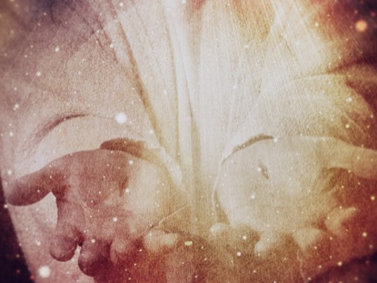
Prayer of Intercession
&
Lord’s Prayer

Slide 74
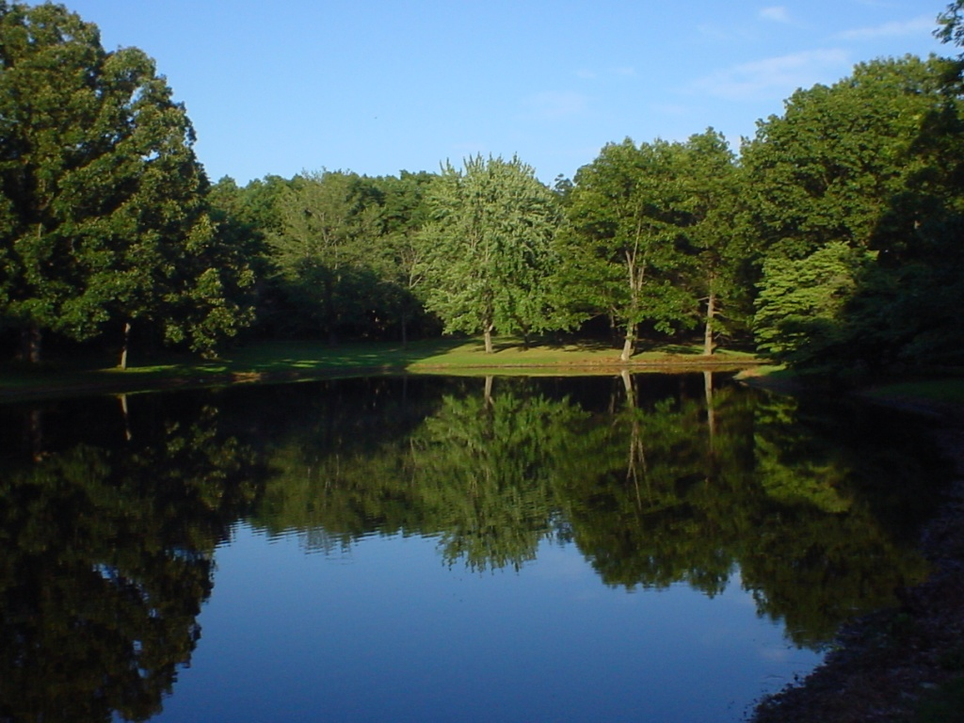
*CLOSING HYMN: VU#559
“Come, O Fount of Every Blessing”

Slide 75
Come, O Fount of every blessing,
tune my heart to sing your grace;
streams of mercy, never ceasing
call for songs of endless praise.
Teach me some melodious sonnet,
sung by flaming tongues above.
Praise the mount; I'm fixed upon it,
mount of God's unfailing love.

Slide 76
Here I pause in my sojourning,
giving thanks for having come,
come to trust, at every turning,
God will guide me safely home.
Jesus sought me when a stranger,
wandering from the fold of God,
came to rescue me from danger,
precious presence, precious blood.

Slide 77
O, to grace how great a debt
or daily I am drawn anew!
Let that grace now, like a fetter,
bind my wandering heart to you.
Prone to wander, I can feel it,
wander from the love I've known:
here's my heart, O, take and seal it,
seal it for your very own.~

Slide 79
CHORAL RESPONSE #884
You shall go out with joy and be led forth with peace, the mountains and the hills will break forth before you, there’ll be shouts of joy, and all the trees of the field will clap, will clap their hands!

Slide 80
And all the trees of the field will clap their hands (clap, clap) the trees of the field will clap their hands (clap, clap), the trees of the field will clap their hands (clap, clap), while you go out with joy!~

Slide 82
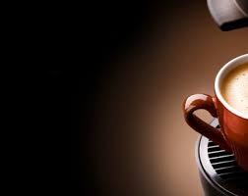
Everyone is invited and encouraged to come for coffee in the LA Hall following service!
Please remember to return your nametag.

