Slide 1



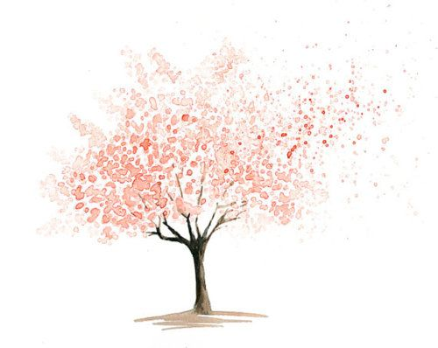

WELCOME

Slide 3

WELCOME
&
ANNOUNCEMENTS

Slide 5
SANCTUS: VU#381
Spirit of Life, come unto me.
Sing in my heart all the stirrings of compassion.
Blow in the wind, rise in the sea;
move in the hand, giving life the shape of justice.
Roots hold me close; wings set me free;
Spirit of Life, come to me, come to me.~

Slide 7
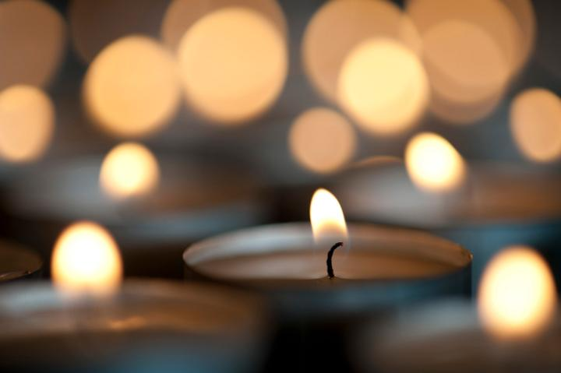
LIGHTING OF THE CANDLES

Slide 9

*HYMN: MV#79
“Spirit, Open my Heart”

Slide 10
Refrain:
Spirit, o – pen my heart to the joy and the pain of liv-ing.
As you love may I love, in receiving and in giv-ing,
Spirit, o – pen my heart.

Slide 11
God, re-place my ston-y heart with a heart that’s kind and ten-der.
All my cold-ness and fear to your grace I now sur-ren-der.

Slide 12
Refrain:
Spirit, o – pen my heart to the joy and the pain of liv-ing.
As you love may I love, in receiving and in giv-ing,
Spirit, o – pen my heart.

Slide 13
Write your love u-pon my heart as my law, my goal, my story.
In each though, word, and deed, may my liv-ing bring you glo-ry.

Slide 14
Refrain:
Spirit, o – pen my heart to the joy and the pain of liv-ing.
As you love may I love, in receiving and in giv-ing,
Spirit, o – pen my heart.~

Slide 16


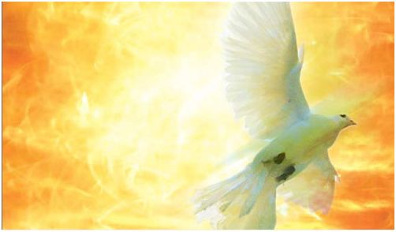
SHARING
OUR
STORIES
SHARING
OUR STORIES

Slide 18
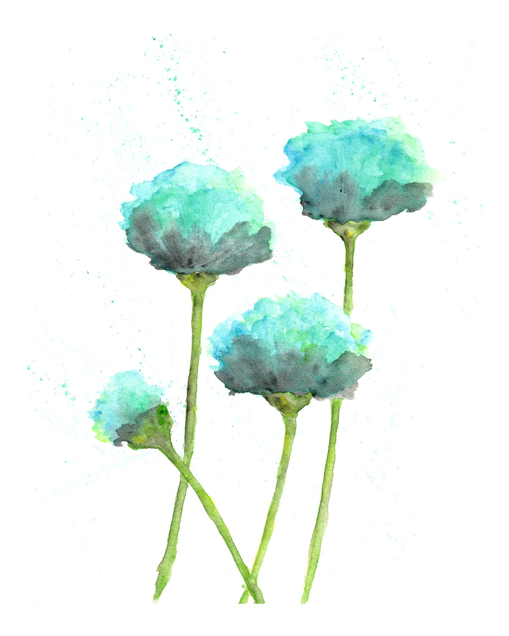
*HYMN: VU#371
“Open My Eyes”

Slide 19
Open my eyes, that I may see glimpses of truth thou hast for me; place in my hands the wonderful key that shall unclasp and set me free.

Slide 20
Refrain:
Silently now I wait for thee, ready, my God, thy will to see. Open my eyes, illumine me, Spirit divine!

Slide 21
Open my mouth, and let me bear gladly the warm truth everywhere; open my heart and let me prepare love with thy children thus to share.

Slide 22
Refrain:
Silently now I wait for thee, ready, my God, thy will to see. Open my eyes, illumine me, Spirit divine!~

Slide 24
SHARING
OUR
STORIES
SHARING
OUR STORIES

Slide 26

*HYMN: VU#595
“We Are Pilgrims”

Slide 27
We are pilgrims on a journey,
fellow travellers on the road;
we are here to help each other
walk the mile and bear the load.

Slide 28
Sister, let me be your servant,
let me be as Christ to you;
pray that I may have the grace to
let you be my servant too.

Slide 29
I will weep when you are weeping,
when you laugh I'll laugh with you;
I will share your joy and sorrow,
till we've seen this journey through.~

Slide 31
OFFERING: VU#544
In gratitude and humble trust
we bring our best today
to serve your cause and share your love
with all along life's way.

Slide 32
O God, who gave yourself to us
in Jesus Christ, your Son,
teach us to give ourselves each day
until life's work is done.~

Slide 34
OFFERTORY PRAYER:
God, whose children we are, receive these gifts we offer. May they help to bring others ever closer to you, and to experience and appreciate your presence in their lives. Amen.

Slide 36
REFLECTING
ON OUR
STORIES
SHARING
OUR STORIES

Slide 39
Refrain:
I see a new heaven.
I see a new earth
as the old one will pass away,
where the fountain of life flows
and without price goes
to all people who abide in the land.

Slide 40
There, there on the banks of a river bright and free,
yielding her fruit, firm in her root,
the Tree of Life will be.
There, there on the banks of a river bright and free,
yielding her fruit, firm in her root,
the Tree of Life will be.

Slide 41
Refrain:
I see a new heaven.
I see a new earth
as the old one will pass away,
where the fountain of life flows
and without price goes
to all people who abide in the land.

Slide 42
There, there where we work with the love of
healing hands.
Labour we must, true to our trust
to build a promised new land.

Slide 43
Refrain:
I see a new heaven.
I see a new earth
as the old one will pass away,
where the fountain of life flows
and without price goes
to all people who abide in the land.~

Slide 45
CHORAL RESPONSE #884
You shall go out with joy and be led forth with peace, the mountains and the hills will break forth before you, there’ll be shouts of joy, and all the trees of the field will clap, will clap their hands!

Slide 46
And all the trees of the field will clap their hands (clap, clap) the trees of the field will clap their hands (clap, clap), the trees of the field will clap their hands (clap, clap), while you go out with joy!~

Slide 48

Everyone is invited and encouraged to come for coffee in the LA Hall following service!
Please remember to return your nametag.

